Slide 1
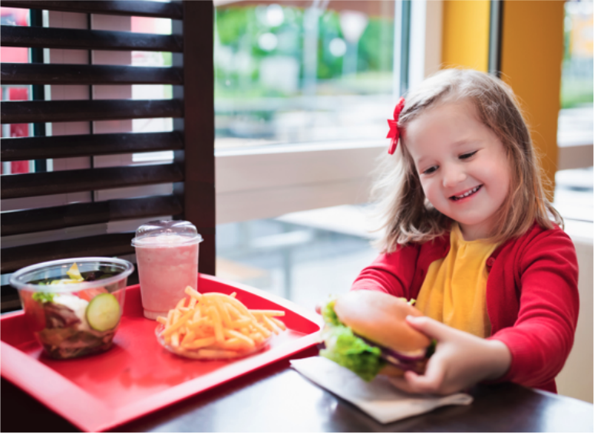


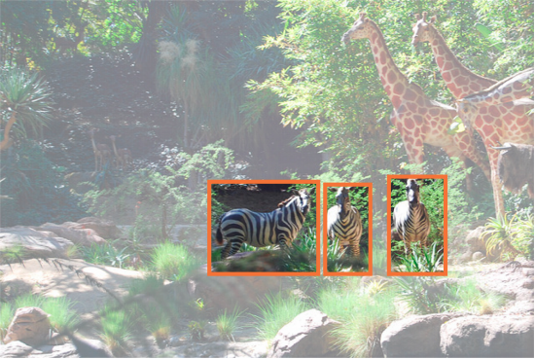
Multimodal Learning and Reasoning for Visual Question Answering
Vasin Srisupavanich | MSc Artificial Intelligence | Supervisor: Dr Srinandan Dasmahapatra
Visual Question Answering
Visual Question Answering (VQA) is the task of answering
Visual Reasoning
A VQA task designed explicitly to test reasoning skills, such as
question about an image.
spatial understanding, counting, comparing, logical
reasoning, and storing information in memory.
Motivation
“What is the girl eating?”
Hamburger
“Is there a drink in the image?”
Yes
“How many plastic containers are there?”
Two
“What is located to the left of the fries?”
Salad
“What colour is the thing under the food
left of the little girl with the yellow shirt?”
Red
Over the last decade, deep learning systems have enjoyed tremendous success in the area of computer vision and natural language understanding. However, they still struggle in tasks which require deliberate thinking and reasoning process. Creating a machine that can learn to reason has been a long-standing goal in the field of Artificial Intelligence (AI).
VQA is a challenging multi-modal AI research problem, which requires both visual and language understanding. Making a progress in this domain would mean a significant step toward a more general AI. In addition, VQA is a great domain to measure the intelligence and reasoning capabilities of a machine, due to the variety of skills required to tackle different types of question.
Current VQA models tend to exploit the dataset biases without capturing the underlying perception and reasoning process to respond to the given question. Moreover, representations of text and visual features are usually independent and not properly aligned, which often make the model bias towards language modality.
Project Aims
Why the project matters?
The aim of this project is to develop a VQA model and evaluate how it performs on the visual reasoning dataset (GQA). The model should be capable of responding to relatively complex questions that require multi-steps reasoning and inference over real-world images.
Effective use of vast amount of visual data
Enhancing human machine interaction
Aiding visually impaired individuals
Reasoning Module
Joint representation from Transformer
Control
Memory
Control
Memory
Three
How many zebras are there?
Control
Memory
GQA Dataset
Methods
A dataset for real-world visual reasoning and question answering [1]
The dataset contains 113k real-world images, and 22M compositional questions involving a diverse set of reasoning skills
Model Development
The first step is to implement the baseline VQA model (LSTM, CNN) to set the benchmark to improve upon. Then the new model architecture will be designed to incorporate the joint representation of image and text [2] with the reasoning module [3].
Qualitative Analysis
Model’s interpretability and explainablity will be explored and visualised (e.g. visualisation of attention mechanism). It will also be useful to study whether the model can generalize to new dataset with different type of questions or images.
Quantitative Analysis
The accuracy from each question type will be analysed and compared with existing models to identify the strength and weakness of the model. Moreover, analysis on data efficiency should give useful insights on how fast the model learns.
References
[1] Hudson, D.A. and Manning, C.D., 2019. Gqa: A new dataset for real-world visual reasoning and compositional question answering. In Proceedings of the IEEE Conference on Computer Vision and Pattern Recognition (pp. 6700-6709).
[2] Su, W., Zhu, X., Cao, Y., Li, B., Lu, L., Wei, F. and Dai, J., 2019. Vl-bert: Pre-training of generic visual-linguistic representations. arXiv preprint arXiv:1908.08530.
[3] Hudson, D.A. and Manning, C.D., 2018. Compositional attention networks for machine reasoning. arXiv preprint arXiv:1803.03067.
[4] Mao, J., Gan, C., Kohli, P., Tenenbaum, J.B. and Wu, J., 2019. The neuro-symbolic concept learner: Interpreting scenes, words, and sentences from natural supervision. arXiv preprint arXiv:1904.12584.
* Images in this poster are taken from [1], [4]

Slide 2
Multimodal Learning and Reasoning for Visual Question Answering
Vasin Srisupavanich | MSc Artificial Intelligence | Supervisor: Dr Srinandan Dasmahapatra
Visual Question Answering
Visual Question Answering (VQA) is the task of answering
Visual Reasoning
A VQA task designed explicitly to test reasoning skills, such as
question about an image.
spatial understanding, counting, comparing, logical
reasoning, and storing information in memory.
Motivation
“What is the girl eating?”
Hamburger
“Is there a drink in the image?”
Yes
“How many plastic containers are there?”
Two
“What is located to the left of the fries?”
Salad
“What colour is the thing under the food
left of the little girl with the yellow shirt?”
Red
Over the past decades, deep learning systems have enjoyed tremendous success in the area of computer vision and natural language understanding. However, they still struggle in tasks which require deliberate thinking and reasoning process. Also, incorporating reasoning ability to machines has been a long-standing goal in the field of Artificial Intelligence.
VQA is a challenging multi-modal AI research problem, which requires both visual and language understanding. Making a progress in this domain would mean a significant step toward a more general artificial intelligence. In addition, VQA is a great domain to measure the intelligence and reasoning capabilities of a machine, due to the variety of skills required to tackle different types of question.
Current VQA models tends to acquire only superficial comprehension of both the image and the question, exploiting dataset biases rather than capturing underlying perception and reasoning process. Representations of texts and images are also separate, and the answer from VQA tends to be bias towards a language modality
Let me know if I can be any help
Project Aims
Why the project matters?
The aim of this project is to develop a VQA model and evaluate how it performs on the visual reasoning dataset (GQA). The model should be capable of responding to relatively complex questions that require multi-steps reasoning and inference over real-world images.
Effective use of vast amount of visual data
Enhancing human machine interaction
Aiding visually impaired individuals
Reasoning Module
Joint representation from Transformer
Control
Memory
Control
Memory
Three
How many zebras are there?
Control
Memory
GQA Dataset
Methods
A dataset for real-world visual reasoning and question answering
The dataset contains 113k real-world images, and 22M compositional questions involving a diverse set of reasoning skills
Model Development
The first step is to implement the baseline VQA model (LSTM, CNN) to set the benchmark to improve upon. Then the new model architecture will be designed to incorporate the joint representation of image and text with the reasoning module.
Qualitative Analysis
Model’s interpretability and explainablity will be explored and visualized (e.g. visualisation of attention mechanism). It will also be useful to study whether the model can generalize to new dataset with different type of questions or images.
Quantitative Analysis
The accuracy from each question types will be analysed and compared with existing models. This will allow the strength and weakness of the model to be identified. Moreover, analysis on data efficiency should give useful insights on how fast the model learns.
References
Hudson, D.A. and Manning, C.D., 2019. Gqa: A new dataset for real-world visual reasoning and compositional question answering. In Proceedings of the IEEE Conference on Computer Vision and Pattern Recognition (pp. 6700-6709).

Slide 3
Multimodal Learning and Reasoning for Visual Question Answering
Vasin Srisupavanich | MSc Artificial Intelligence | Supervisor: Dr Srinandan Dasmahapatra
Visual Question Answering
Visual Question Answering (VQA) is the task of answering
Visual Reasoning
A VQA task designed explicitly to test reasoning skills, such as
question about an image.
spatial understanding, counting, comparing, logical
reasoning, and storing information in memory.
Motivation
“What is the girl eating?”
Hamburger
“Is there a drink in the image?”
Yes
“How many plastic containers are there?”
Two
“What is located to the left of the fries?”
Salad
“What colour is the thing under the food
left of the little girl with the yellow shirt?”
Red
Over the past decades, deep learning systems have enjoyed tremendous success in the area of computer vision and natural language understanding. However, they still struggle in tasks which require deliberate thinking and reasoning process. Also, incorporating reasoning ability to machines has been a long-standing goal in the field of Artificial Intelligence.
VQA is a challenging multi-modal AI research problem, which requires both visual and language understanding. Making a progress in this domain would mean a significant step toward a more general artificial intelligence. In addition, VQA is a great domain to measure the intelligence and reasoning capabilities of a machine, due to the variety of skills required to tackle different types of question.
Current VQA models tends to acquire only superficial comprehension of both the image and the question, exploiting dataset biases rather than capturing underlying perception and reasoning process. Representations of texts and images are also separate, and the answer from VQA tends to be bias towards a language modality
Project Aims
Why the project matters?
The aim of this project is to develop a VQA model and evaluate how it performs on the visual reasoning dataset (GQA). The model should be capable of responding to relatively complex questions that require multi-steps reasoning and inference over real-world images.
Effective use of vast amount of visual data
Enhancing human machine interaction
Aiding visually impaired individuals
Reasoning Module
Joint representation from Transformer
Control
Memory
Control
Memory
Three
How many zebras are there?
Control
Memory
GQA Dataset
A dataset for real-world visual reasoning and question answering
The dataset contains 113k real-world images, and 22M compositional questions involving a diverse set of reasoning skills
Methods
Model Development
The first step is to implement the baseline VQA model (LSTM, CNN) to set the benchmark to improve upon. Then the new model architecture will be designed to incorporate the joint representation of image and text with the reasoning module.
Qualitative Analysis
Model’s interpretability and explainablity will be explored and visualized (e.g. visualisation of attention mechanism). It will also be useful to study whether the model can generalize to new dataset with different type of questions or images.
Quantitative Analysis
The accuracy from each question types will be analysed and compared with existing models. This will allow the strength and weakness of the model to be identified. Moreover, analysis on data efficiency should give useful insights on how fast the model learns.
References
Hudson, D.A. and Manning, C.D., 2019. Gqa: A new dataset for real-world visual reasoning and compositional question answering. In Proceedings of the IEEE Conference on Computer Vision and Pattern Recognition (pp. 6700-6709).

